Slide 1
Object-Oriented Programming
Endah Septa Sintiya,S.Pd.,M.Kom

Slide 2



Rules
Don't be late
Don't call (WA Only)
Monday-Friday(07.00 - 18.00 WIB)
Don't cheat
Discount 50%

Slide 3
Outline
PBO vs Structural Basic concepts of PBO

Slide 4
OOP Courses
Object-Based Programming (2 credits/4x50 minutes) Object-Based Programming Practicum (2 credits/4x50 minutes) Learning Outcomes Able to create programs using OOP principles using the Java programming language

Slide 5
Syllabus
The Meeting | Discussion
1 | Introduction to Basic Concepts of OOP
2 | Classes and Objects
3 | Encapsulation
4 | Class Relations
5 | Quiz 1
6 | Inheritance
7 | Overriding and Overloading
8 | Mid-Term Exam
9 | Abstract Class
10 | Interface
11 | Polimorfisme
12 | Quiz 2
13-16 | OOP on other programming languages
17 | Final Semester Exam

Slide 6
Programming Object-Oriented
Programming Structural
Vs

Slide 7
— STRUCTURAL PROGRAMMING
Programming paradigm with the concept that a program is a sequence of steps taken to solve a problem

Slide 8
Structural Programming
Example:
We will make a bicycle simulation game program, in which there is a bicycle object that has speed, gear and brand.
How to build the game with a structural method?
The first step is to make the variables, for example speed, gear, brand
The next step is to make the functions, increase the speed, decrease the speed
The next step we try to operate the bike simply, namely manipulating the speed, gears, brand, in the main function, then we print it on the screen
Program code→…

Slide 9
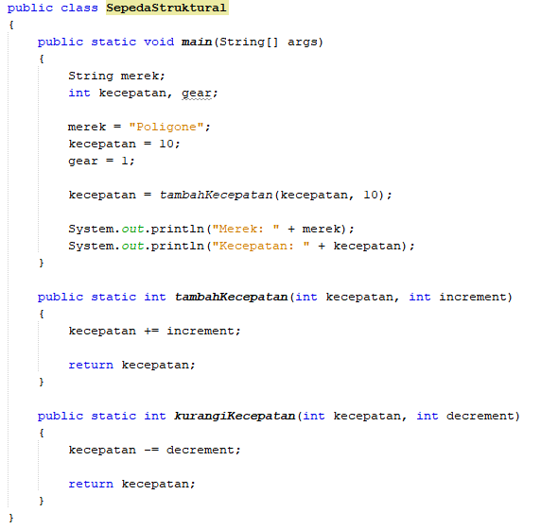

Slide 10
Structural Programming
What if there were two bikes in the game? Add variables brand2, speed2, gear2 Try manipulating the values of the variables and then display them on the screen The program code ...

Slide 11
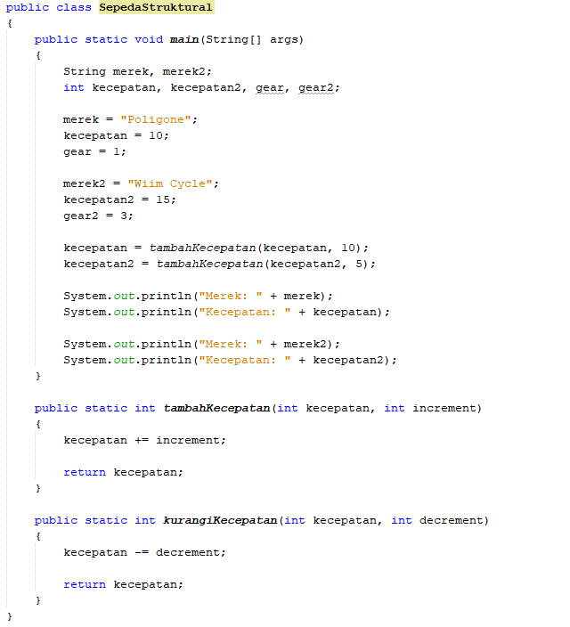
12 baris

Slide 12
Object Oriented vs Structural
What if there were ten bikes? Add the variables brand3, speed3, gear3 ..................... Brand10, Speed10, Gear10

Slide 13
Algorithms + Data Structures = Programs (Niklaus Wirth, 1975, Prentice Hall)

Slide 14
— OBJECT-ORIENTED PROGRAMMING
Object-focused programming paradigm
Data + Algorithm

Slide 15
OOP Concept
Some aspects in OOP: Object Class Encapsulation Inheritance Polymorphism

Slide 16
CLASS & OBJECT

Slide 17
— OBJECT
Who and what is involved in the business process?

Slide 18












ACADEMIC INFORMATION SYSTEMS
ACCOUNTANCY
Aljabar Linear
Numerical Analysis Discrete Mathematics
Calculus 2
CIVIL ENGINEERING CHEMICAL ENGINEERING
ACCOUNTANCY

Slide 19
ACADEMIC INFORMATION SYSTEMS
Numerical Analysis Discrete Mathematics Linear Algebra Calculus 2
ACCOUNTANCY INFORMATICS ENGINEERING CIVIL ENGINEERING CHEMICAL ENGINEERING

Slide 20
What does it have?
CHARACTERISTIC
What can be done?

Slide 21

What does a student object have?
Name NIM Date of Birth Gender Address
—ATRIBUT: Variables/properties/characteristics/states/properties owned by an object

Slide 22
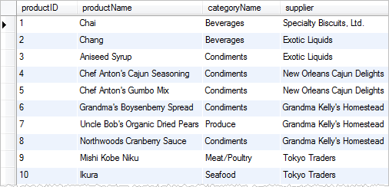

Slide 23
What can be done by/against the student object?
—METHOD: Procedures/functions/behaviors/processes that can be performed by/on an object
Choosing a course View grades Apply for academic leave

Slide 24
ACADEMIC INFORMATION SYSTEMS
Numerical Analysis Discrete Mathematics Linear Algebra Calculus 2
ACCOUNTANCY INFORMATICS ENGINEERING CIVIL ENGINEERING MATHEMATICS

Slide 25
— CLASS
Blueprints/templates/templates that define the characteristics (attributes and methods) of objects in the

Slide 26
— OBJECT
An object is a representation of any entity involved in a system (both real and unreal) Each object will have a set of variables/traits/states with values attached to them

Slide 27

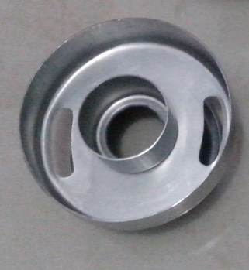
Class Donat
6 Objects in the Donut Class

Slide 28
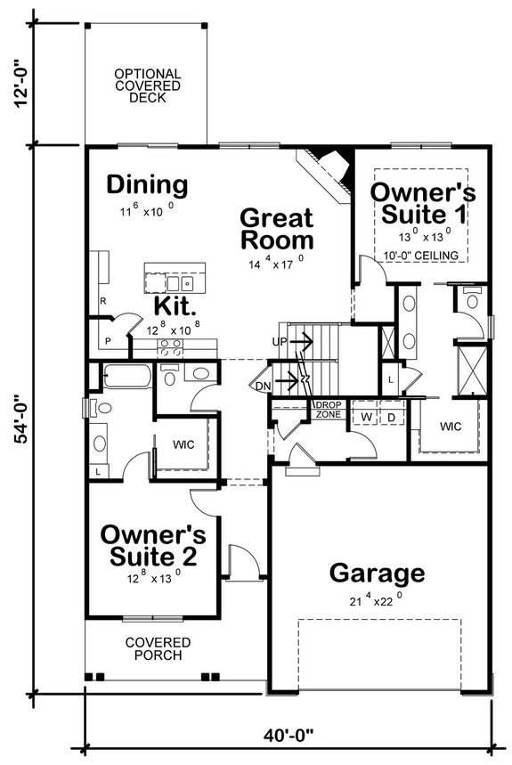

Class House
3 Objects in the House Class

Slide 29
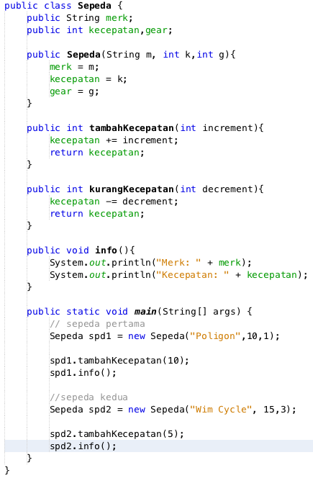
6 baris

Slide 30
Assessment Components
Theory:
QUIZ | : | 2 | 25 | %
TASK | : | 6 | 20 | %
Mid Exam | : | 1 | 20 | %
Final Exam | : | 1 | 25 | %
Practice:
Quiz | : | 2 | 20 | %
Task | : | 12 | 30 | %
Mid Exam | : | 1 | 20 | %
Final Exam | : | 1 | 30 | %

Slide 31
Conclusion
Structural
Programs broken down into functions/procedures
Feature changes→ the possibility of disrupting the entire program
Object Oriented
Programs are broken down into objects
In it there are states and behaviors
Feature changes→ does not interfere with the entire program

Slide 32
Exercise
Look for any object in the real world as many as 5.
Write down the object's state/attributes and behavior/method. The more states and behaviors the better. Example:
TV
State:
Brand
Screen size
Channel
Volume
Behavior:
Turn on
Turn off
Switch channels
Increase volume
Reduce volume

Slide 33
References
Horstmann, C. S., & Cornell, G. (2007). Core Java Volume I–Fundamentals, Eighth Edition. Network Circle, Santa Clara: Prentice Hall.
Horstmann, C. S., & Cornell, G. (2008). Core Java Volume II–Advanced Features, Eighth Edition. Network Circle, Santa Clara: Prentice Hall.
https://www.javatpoint.com/java-oops-concepts

